Slide 1

GURU NANAK INSTITUTE OF TECHNOLOGY
Ibrahimpatnam, R.R. Dist. 501506.
Department Of
ARTIFICIAL INTELLIGENCE AND DATA SCIENCE
IDENTIFICATION OF CREDIT CARD FRAUDS USING MACHINE LEARNING AND DEEP LEARNING
UNDER GUIDENCE
OF
Dr. SHEETAL KUNDRA
Professor & HOD
PRESENTED BY:
C.S ABHINAY 21831A7214
ARAVIND.M 21831A7203
D.S PRATHAMESH 21831A7217

Slide 2
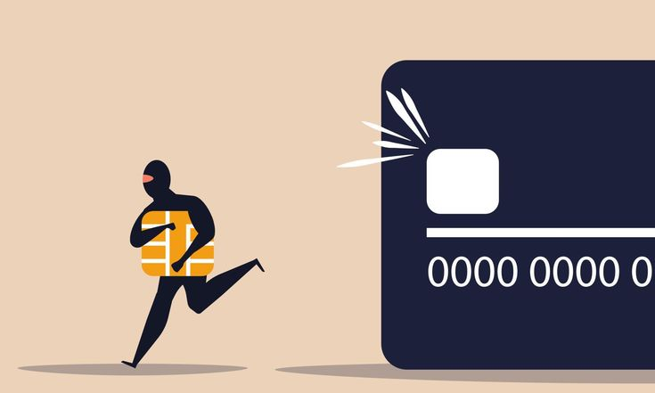
What are credit card frauds?
Credit card fraud is the unauthorized use of a
credit card or credit card details to make
transactions without the cardholder's consent.
Card Theft & Skimming
Online & Card-Not-Present (CNP) Fraud
Identity Theft & Account Takeover
Phishing & Social Engineering

Slide 3
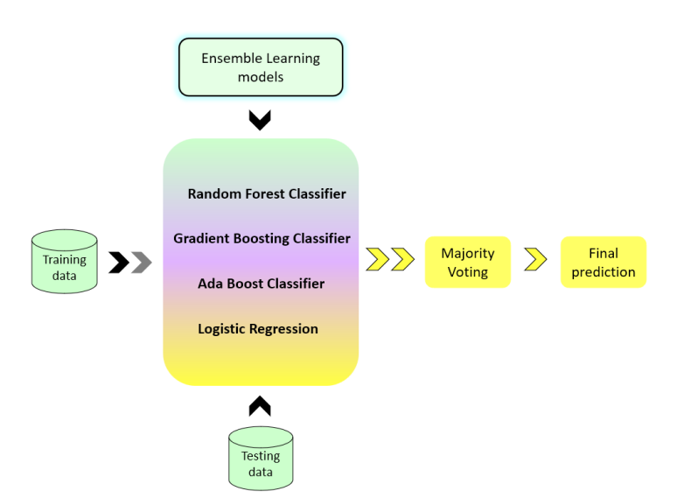
Existing System
Algorithms used:
Logistic Regression
Random Forest Classifier
Gradient Boosting Classifier
Ada Boosting Classifier

Slide 4
Drawbacks
Imbalanced Data
Overfitting
Limited Accuracy
Fraudulent transactions are rare, making it hard for models to generalize.
Many models perform well
during training but fail in
real-world applications.
Traditional models fail to capture
complex patterns in large
datasets.

Slide 5
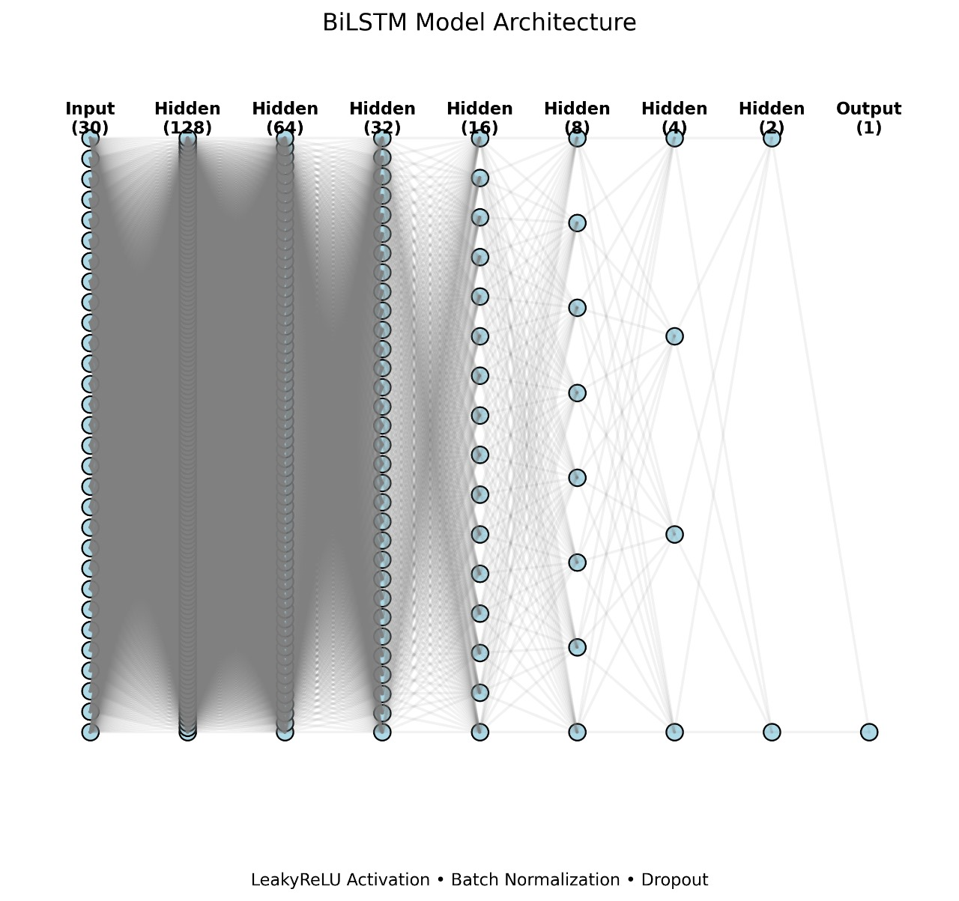
Proposed System
* Sequential deep learning model
*Bi-LSTM model- It is a type of RNN

Slide 6

Why Use Deep Learning ?
Handles Complexity
High Accuracy
Feature Extraction
DL models can identify intricate patterns in large datasets.
Techniques like ANN enhance sequence learning, improving fraud detection rates.
Automatically detects important features without extensive manual engineering.

Slide 7
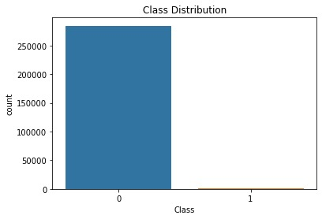
Data Set Overview:
Source: Kaggle
Records: 284,807 transactions (2-day period, Sept 2013)
Fraud Cases: 492 (≈0.17%) – Highly imbalanced
Features: Time, Amount, V1–V28(anonymized features )
Class: Target (0 = Legitimate, 1 = Fraud)
Dataset Link

Slide 8
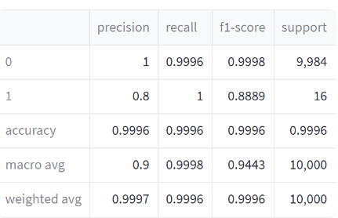
Results:
High overall accuracy: 99.96%
Fraud detection recall: 100% – no fraud cases missed
Fraud precision: 80% – some false positives exist
Balanced performance using Bi-LSTM on imbalanced data

Slide 9
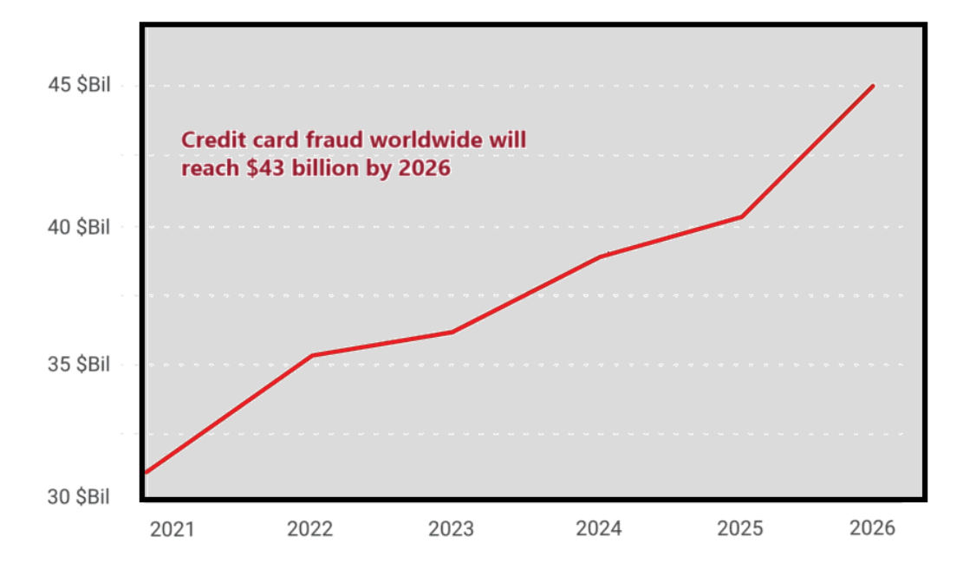
Loss due to frauds:
Financial Impact
Mitigation
Customer Trust
Digital Economy

Slide 10
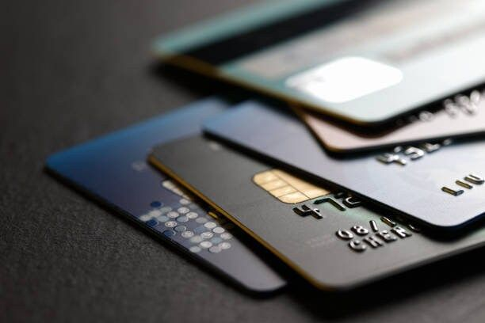
Conclusions: Based on our Project
@Improved Accuracy
@Efficient Implementation
@Real time fraud detection

Slide 11

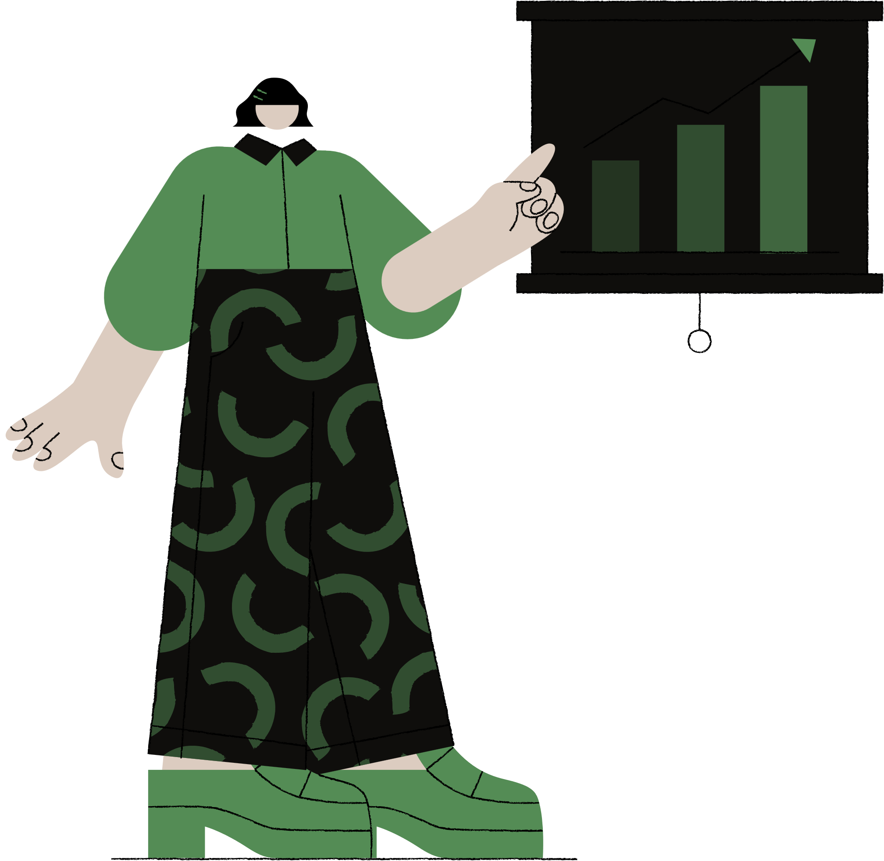

Enhancements:
Chatbot & AI Agent :
Provides real-time transaction updates,
flags issues, and manages credit card bills.
Agent Link
Interactive Website
To display fraud detection results
and allow users to upload datasets.
Website Link

Slide 12
Thank You

